Slide 1
SPACE SERVICING AND ASSEMBLY: CHANGING THE WAY WE DO SPACE
Gordon Roesler
Robots in Space®️ LLC

Slide 2
Job security for space: broadband
>20%
YoY
growth

Slide 3
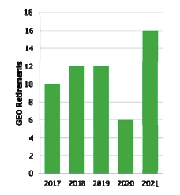
Our disposable satellite culture
INTELSAT 29E
TOTAL LOSS
NOT INSPECTED
VIASAT-2
$188M PAYOUT
NOT REPAIRED
GEO RETIREMENTS
$3B PER YEAR
NOT REFUELED

Slide 4
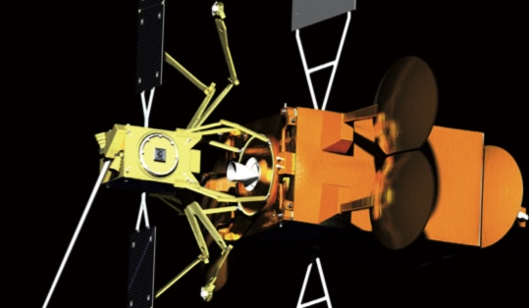
FIRST GENERATION: LIFE EXTENSION
NORTHROP GRUMMAN
MISSION EXTENSION VEHICLE
2019
EFFECTIVE SPACE
SPACE DRONE
2021-22

Slide 5
LIFE EXTENSION TAKEAWAYS
NO SPECIAL ADAPTERS NEEDED
AVAILABLE IN 2020
FLEET FLEXIBILITY
ADDED REVENUES

Slide 6
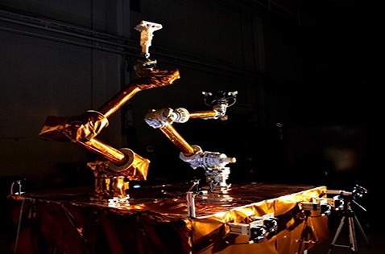
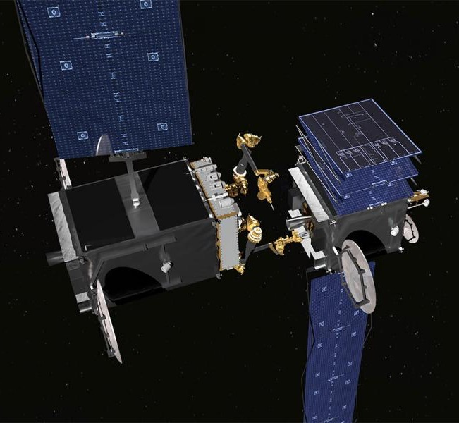
SECOND GENERATION : REPAIR, UPGRADE
NAVAL RESEARCH LAB
ROBOTICS OPERATIONS TESTBED
IN OPERATION 2018
DARPA RSGS
ROBOTIC SERVICING OF GEOSYNCHRONOUS
SATELLITES 2022

Slide 7
ROBOTIC SERVICING TAKEAWAYS
NO SPECIAL ADAPTERS NEEDED
AVAILABLE IN 2022
CORRECTION OF DEPLOYMENT ANOMALIES
ADD CAPABILITIES TO OPERATING SPACECRAFT
ULTRA-CLOSE INSPECTION
REDUCED INSURANCE CLAIMS

Slide 8
THIRD GENERATION: MANUFACTURING
MADE IN SPACE
ARCHINAUT
2024

Slide 9
THIRD GENERATION: ASSEMBLY
MAXAR
DRAGONFLY
2022

Slide 10
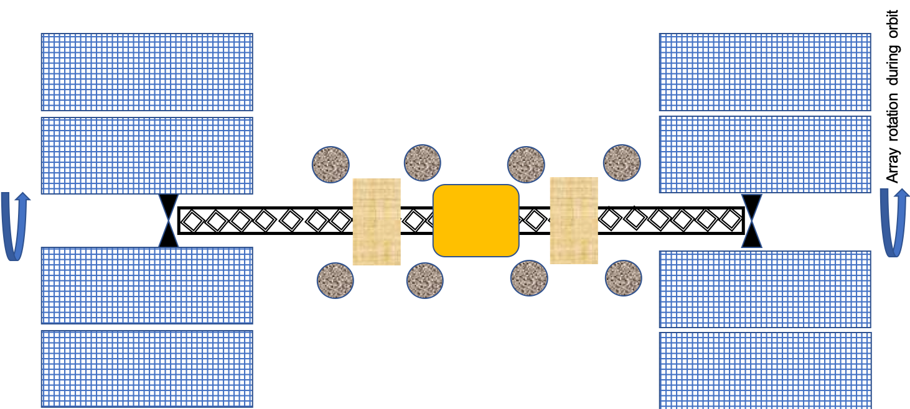
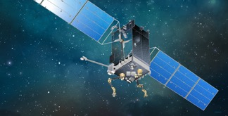
GEO PLATFORM

Slide 11
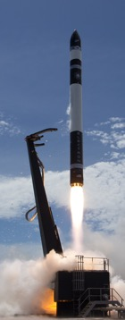
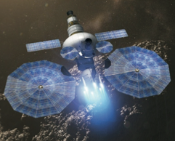
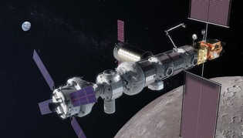
REUSABLE In-space transportation

Slide 12
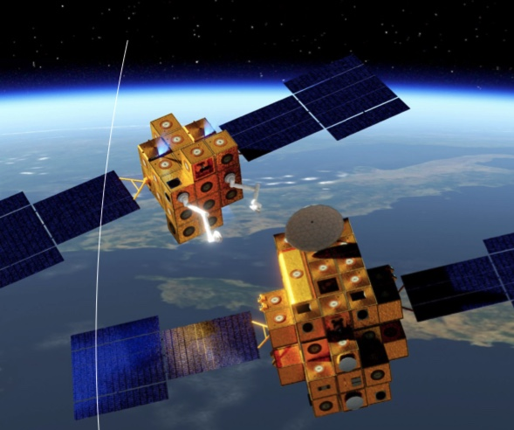
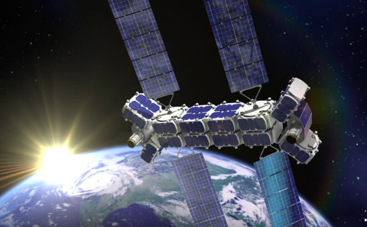
fourth GENERATION: MODULAR SATELLITES
DLR
iBOSS
NovaWurks
Conformal Satellite
HISat modules flight tested 2018

Slide 13
THANK YOU FOR YOUR INTEREST
LET’S UNLOCK THE VALUE OF SPACE
robotsinspacellc@gmail.com
www.robots-in.space

